Slide 1
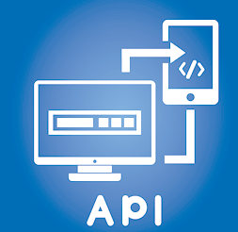


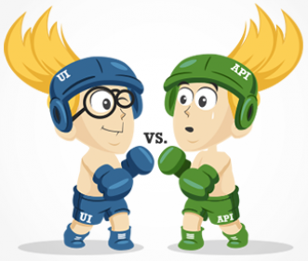
API Testing

Slide 2
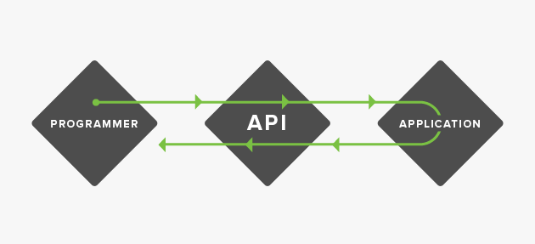

API - Overview
An API is a set of functions and procedures that allow the creation of applications which access the features or data of an operating system, application, or other service.
API is a set of programming instructions and standards for accessing a Web-based software application or Web tool. A software company releases its API to the public so that other software developers can design products that are powered by its service.
For example, Amazon.com released its API so that third party Web site developers could more easily access Amazon's product information with updated prices and an option to "buy now."

Slide 3
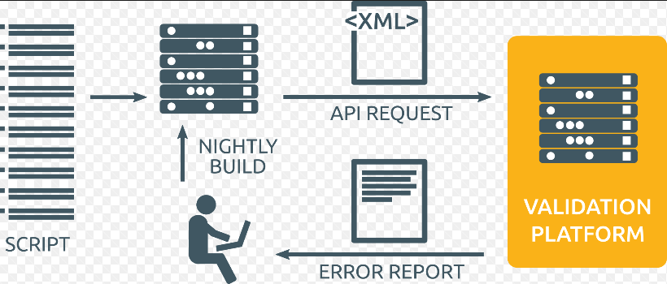
Approach of API Testing
Understanding the functionality of the API program and clearly define the scope of the program
Apply testing techniques such as equivalence classes, boundary value analysis and error guessing and write test cases for the API
Input Parameters for the API need to be planned and defined appropriately
Execute the test cases and compare expected and actual results.

Slide 4
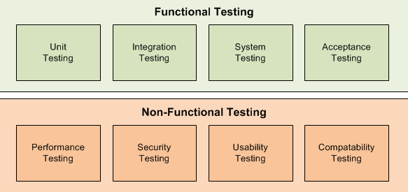
Types of API testing
API testing typically involves the following practices:
Unit testing - Testing the functionality of individual operations.
Functional testing - Testing the functionality of broader scenarios, often using unit tests as building blocks for end-to-end tests. Includes test case definition, execution, validation, and regression testing.
Load testing - Validating functionality and performance under load, often by reusing functional test cases.
Runtime error detection - Monitoring an application the execution of automated or manual tests to expose problems such as race conditions, exceptions, and resource leaks.
Security testing - Includes penetration testing and fuzz testing as well as validating authentication, encryption, and access control.

Slide 5
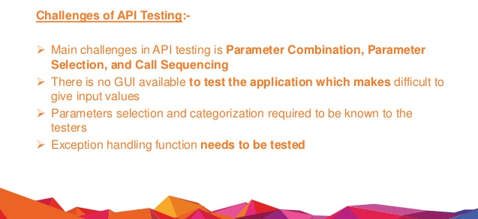
Challenges of API Testing

Slide 6




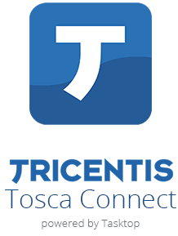
API Testing Tools
The below are some of the tools that met their criteria for API Testing and Test Automation.

Slide 7

Questions?

Slide 8

Avinash.M

